Slide 1
Lecture 11: Convolutional Neural Networks 2

Slide 2
Outline
Review from last lecture
Training CNNs
BackProp of MaxPooling layer
Layers Receptive Field
Saliency maps
Transfer Learning
A bit of history

Slide 3
Outline
Review from last lecture
Training CNNs
BackProp of MaxPooling layer
Layers Receptive Field
Saliency maps
Transfer Learning
A bit of history

Slide 4

From last lecture
+ ReLU
+ ReLU

Slide 5
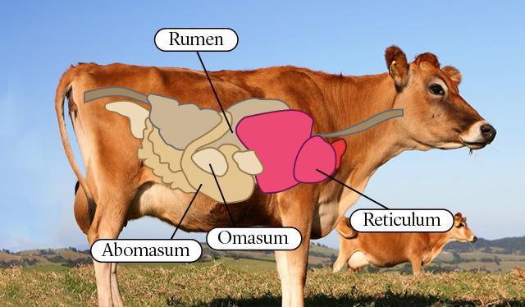
Lab
Lecture
Quiz
Homework

Slide 6
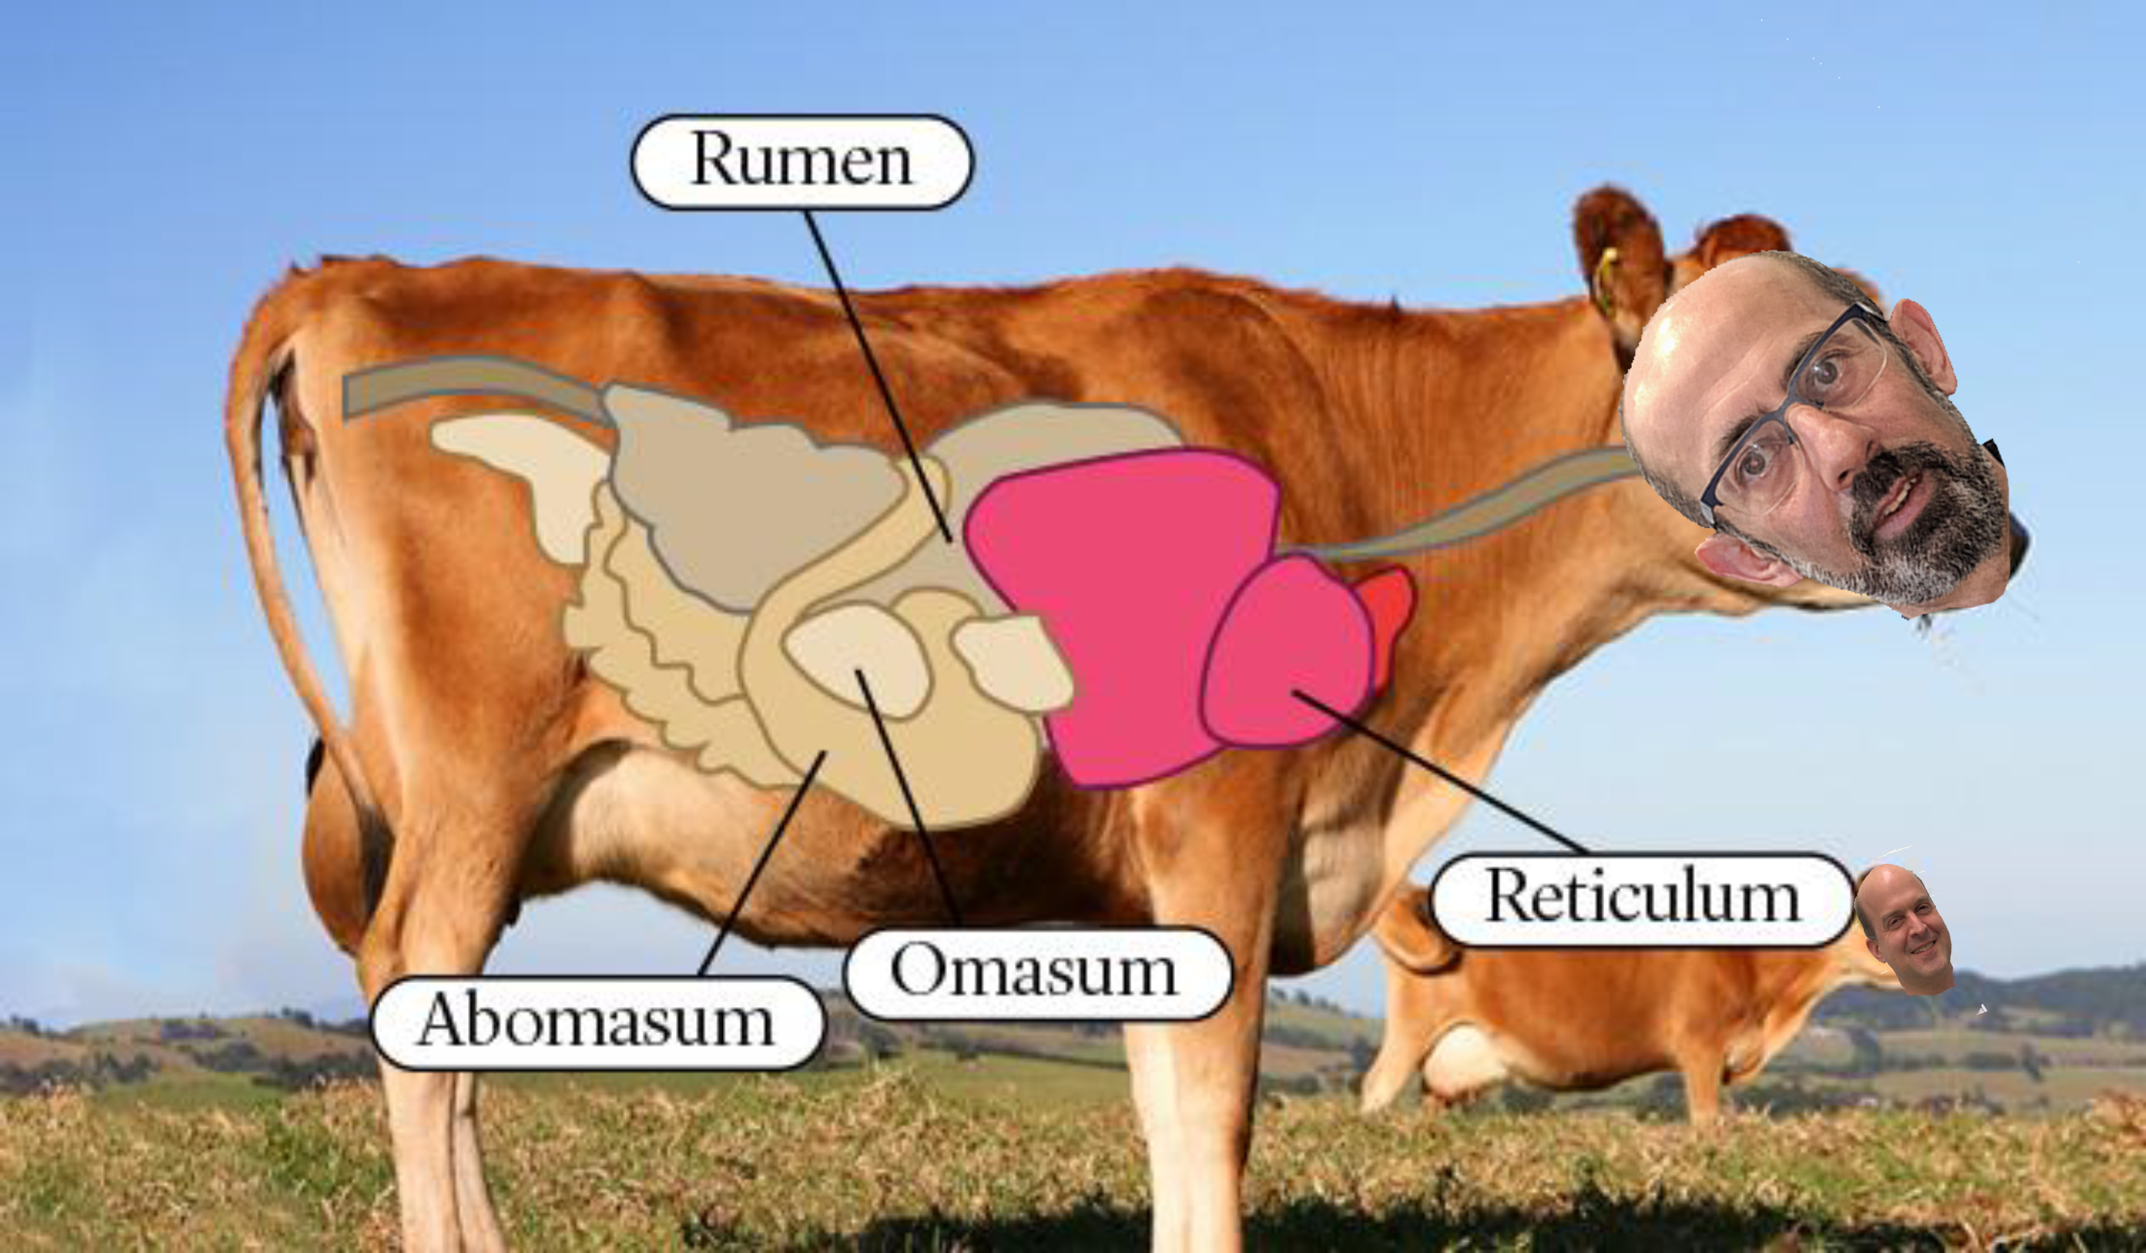
Lab
Lab
Lecture
Lecture
Quiz
Quiz
Homework
Homework

Slide 7
Input
(size=32X32,
channels=3)
1 Filter
(size=3x3X3,
stride = 1,
padding = same)
Output
(size=32X32)
How many parameters does the layer have?
n_filter x filter_volume + biases = total number of params
1 x (3 x 3 x 3) + 1 = 28

Slide 8
Examples
I have a convolutional layer with 16 3x3 filters that takes an RGB image as input.
How many parameters does the layer have?
16 x 3 x 3 x 3 + 16 = 448
Number of filters
Size of Filters
Number of channels of prev layer
Biases (one per filter)
Notes:
ADD A FIGURE

Slide 9
Examples
Let C be a CNN with the following disposition:
Input: 32x32x3 images
Conv1: 8 3x3 filters, stride 1, padding=same
Conv2: 16 5x5 filters, stride 2, padding=same
Flatten layer
Dense1: 512 nodes
Dense2: 4 nodes
How many parameters does this network have?
(8 x 3 x 3 x 3 + 8) + (16 x 5 x 5 x 8 + 16) + (16 x 16 x 16 x 512 + 512) + (512 x 4 + 4)
Conv1
Conv2
Dense1
Dense2
Notes:
NEEDS A FIGURE

Slide 10
Input
(size=32X32,
channels=3)
Filter
8 x (size=3X3x3,
stride = 1,
padding = same)
Output
(size=32X32,
channels = 8)
filter x 1
How many parameters does the layer have if I want to use 8 filters?
n_filters x filter_volume + biases = total number of params
8 x (3 x 3 x 3) + 8 = 224

Slide 11
Input
(size=32X32,
channels=8)
Filter
16 x (size=5X5X8,
stride = 2,
padding = same)
Output
(size=16X16,
channels=16)
16 filters
How many parameters does the layer have if I want to use 16 filters?
n_filters x filter_volume + biases = total number of params
16 x (5 x 5 x 8) + 16 = 3216

Slide 12
Input
(size=16X16,
channels=16)
Flatten
(size= 16X16X16)
Fully Connected
(n_nodes=512)
Fully Connected
(n_nodes=4)
How many parameters … ?
input x FC1_nodes + FC2_nodes = total number of params
(16x16x16) x 512 + 512 + 512 x 4 + 4 = 2,099,716

Slide 13
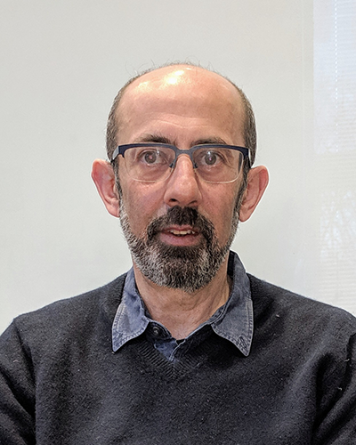
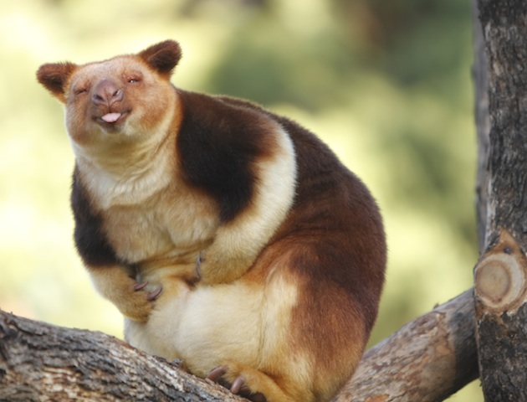
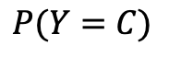
Representation Learning
Task: classify cars, people, animals and objects
FCN
CNN Layer 1
CNN Layer 2
CNN Layer n
…
$$P(Y=C)$$

Slide 14
What do CNN layers learn?
Each CNN layer learns filters of increasing complexity.
The first layers learn basic feature detection filters: edges, corners, etc.
The middle layers learn filters that detect parts of objects. For faces, they might learn to respond to eyes, noses, etc.
The last layers have higher representations: they learn to recognize full objects, in different shapes and positions.

Slide 15
3D visualization of networks in action
http://scs.ryerson.ca/~aharley/vis/conv/
https://www.youtube.com/watch?v=3JQ3hYko51Y

Slide 16
Outline
Review from last lecture
Training CNNs
BackProp of MaxPooling layer
Layers Receptive Field
Saliency maps
Transfer Learning
A bit of history

Slide 17

Notes:
Reminder them that this is exactly the same as in FCN – backprop – need a figure

Slide 18
Outline
Review from last lecture
Training CNNs
BackProp of MaxPooling layer
Layers Receptive Field
Saliency maps
Transfer Learning
A bit of history

Slide 19
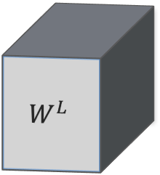
Backward propagation of Maximum Pooling Layer
Forward mode, 3x3 stride 1
Activation of layer L
2 | 4 | 8 | 3 | 6
9 | 3 | 4 | 2 | 5
5 | 4 | 6 | 3 | 1
2 | 3 | 1 | 3 | 4
2 | 7 | 4 | 5 | 7
rest of the network
rest of the network
$$W^{L}$$

Slide 20
Backward propagation of Maximum Pooling Layer
Forward mode, 3x3 stride 1
Activation of layer L
2 | 4 | 8 | 3 | 6
9 | 3 | 4 | 2 | 5
5 | 4 | 6 | 3 | 1
2 | 3 | 1 | 3 | 4
2 | 7 | 4 | 5 | 7
9
rest of the network
rest of the network
$$W^{L}$$

Slide 21
Backward propagation of Maximum Pooling Layer
Forward mode, 3x3 stride 1
Activation of layer L
2 | 4 | 8 | 3 | 6
9 | 3 | 4 | 2 | 5
5 | 4 | 6 | 3 | 1
2 | 3 | 1 | 3 | 4
2 | 7 | 4 | 5 | 7
9 | 8
rest of the network
rest of the network
$$W^{L}$$

Slide 22
Backward propagation of Maximum Pooling Layer
Forward mode, 3x3 stride 1
Activation of layer L
2 | 4 | 8 | 3 | 6
9 | 3 | 4 | 2 | 5
5 | 4 | 6 | 3 | 1
2 | 3 | 1 | 3 | 4
2 | 7 | 4 | 5 | 7
9 | 8 | 8
rest of the network
rest of the network
$$W^{L}$$

Slide 23
Backward propagation of Maximum Pooling Layer
Forward mode, 3x3 stride 1
Activation of layer L
2 | 4 | 8 | 3 | 6
9 | 3 | 4 | 2 | 5
5 | 4 | 6 | 3 | 1
2 | 3 | 1 | 3 | 4
2 | 7 | 4 | 5 | 7
9 | 8 | 8
9 | 6 | 6
7 | 7 | 7
rest of the network
rest of the network
$$W^{L}$$

Slide 24
Backward propagation of Maximum Pooling Layer
Backward mode. Large fonts represents the values of the derivatives of the current layer (max-pool) and small font the corresponding value of the previous layer.
Activation of layer L
2 | 4 | 8 | 3 | 6
9 | 3 | 4 | 2 | 5
5 | 4 | 6 | 3 | 1
2 | 3 | 1 | 3 | 4
2 | 7 | 4 | 5 | 7
1 ₉ | 3 ₈ | 1 ₈
1 ₉ | 4 ₆ | 2 ₆
6 ₇ | 2 ₇ | 1 ₇
rest of the network
rest of the network
$$W^{L}$$

Slide 25
Backward propagation of Maximum Pooling Layer
Backward mode. Large fonts represents the values of the derivatives of the current layer (max-pool) and small font the corresponding value of the previous layer.
Activation of layer L
2 | 4 | 8 | 3 | 6
9 | 3 | 4 | 2 | 5
5 | 4 | 6 | 3 | 1
2 | 3 | 1 | 3 | 4
2 | 7 | 4 | 5 | 7
1 ₉ | 3 ₈ | 1 ₈
1 ₉ | 4 ₆ | 2 ₆
6 ₇ | 2 ₇ | 1 ₇
rest of the network
rest of the network
$$W^{L}$$

Slide 26
Backward propagation of Maximum Pooling Layer
Backward mode. Large fonts represents the values of the derivatives of the current layer (max-pool) and small font the corresponding value of the previous layer.
Activation of layer L
2 | 4 | 8 | 3 | 6
9 | 3 | 4 | 2 | 5
5 | 4 | 6 | 3 | 1
2 | 3 | 1 | 3 | 4
2 | 7 | 4 | 5 | 7
1 ₉ | 3 ₈ | 1 ₈
1 ₉ | 4 ₆ | 2 ₆
6 ₇ | 2 ₇ | 1 ₇
rest of the network
rest of the network
$$W^{L}$$

Slide 27
Backward propagation of Maximum Pooling Layer
Backward mode. Large fonts represents the values of the derivatives of the current layer (max-pool) and small font the corresponding value of the previous layer.
Activation of layer L
2 | 4 | 8 | 3 | 6
9 | 3 | 4 | 2 | 5
5 | 4 | 6 | 3 | 1
2 | 3 | 1 | 3 | 4
2 | 7 | 4 | 5 | 7
+1
1 ₉ | 3 ₈ | 1 ₈
1 ₉ | 4 ₆ | 2 ₆
6 ₇ | 2 ₇ | 1 ₇
rest of the network
rest of the network
$$W^{L}$$

Slide 28
Backward propagation of Maximum Pooling Layer
Backward mode. Large fonts represents the values of the derivatives of the current layer (max-pool) and small font the corresponding value of the previous layer.
Activation of layer L
2 | 4 | 8 | 3 | 6
9 | 3 | 4 | 2 | 5
5 | 4 | 6 | 3 | 1
2 | 3 | 1 | 3 | 4
2 | 7 | 4 | 5 | 7
+1
1 ₉ | 3 ₈ | 1 ₈
1 ₉ | 4 ₆ | 2 ₆
6 ₇ | 2 ₇ | 1 ₇
rest of the network
rest of the network
$$W^{L}$$

Slide 29
Backward propagation of Maximum Pooling Layer
Backward mode. Large fonts represents the values of the derivatives of the current layer (max-pool) and small font the corresponding value of the previous layer.
Activation of layer L
+3
2 | 4 | 8 | 3 | 6
9 | 3 | 4 | 2 | 5
5 | 4 | 6 | 3 | 1
2 | 3 | 1 | 3 | 4
2 | 7 | 4 | 5 | 7
+1
1 ₉ | 3 ₈ | 1 ₈
1 ₉ | 4 ₆ | 2 ₆
6 ₇ | 2 ₇ | 1 ₇
rest of the network
rest of the network
$$W^{L}$$

Slide 30
Backward propagation of Maximum Pooling Layer
Backward mode. Large fonts represents the values of the derivatives of the current layer (max-pool) and small font the corresponding value of the previous layer.
Activation of layer L
+3
2 | 4 | 8 | 3 | 6
9 | 3 | 4 | 2 | 5
5 | 4 | 6 | 3 | 1
2 | 3 | 1 | 3 | 4
2 | 7 | 4 | 5 | 7
+1
1 ₉ | 3 ₈ | 1 ₈
1 ₉ | 4 ₆ | 2 ₆
6 ₇ | 2 ₇ | 1 ₇
rest of the network
rest of the network
$$W^{L}$$

Slide 31
Backward propagation of Maximum Pooling Layer
Backward mode. Large fonts represents the values of the derivatives of the current layer (max-pool) and small font the corresponding value of the previous layer.
Activation of layer L
+4
2 | 4 | 8 | 3 | 6
9 | 3 | 4 | 2 | 5
5 | 4 | 6 | 3 | 1
2 | 3 | 1 | 3 | 4
2 | 7 | 4 | 5 | 7
+1
1 ₉ | 3 ₈ | 1 ₈
1 ₉ | 4 ₆ | 2 ₆
6 ₇ | 2 ₇ | 1 ₇
rest of the network
rest of the network
$$W^{L}$$

Slide 33
Outline
Review from last lecture
Training CNNs
BackProp of MaxPooling layer
Layers Receptive Field, dilated CNNs
Saliency maps
Transfer Learning
A bit of history

Slide 34
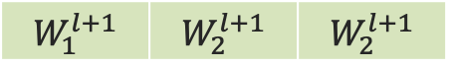

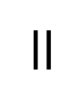

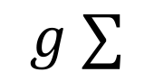


Layers Receptive Field
Let’s look at the receptive field again in 1D, no padding, stride 1 and kernel 3x1
$$a_{1}^{l+1}$$
$$=$$
$$W_{1}^{l+1}$$ | $$W_{2}^{l+1}$$ | $$W_{2}^{l+1}$$
$$g ∑$$
$$×$$
$$×$$
$$×$$
layer l

Slide 35

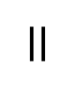

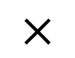
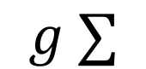
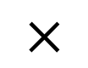
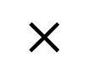
Layers Receptive Field
Let’s look at the receptive field again in 1D, no padding, stride 1 and kernel 3x1
$$a_{1}^{l+1}$$
$$a_{2}^{l+1}$$
$$=$$
$$W_{1}^{l+1}$$ | $$W_{2}^{l+1}$$ | $$W_{2}^{l+1}$$
$$g ∑$$
$$×$$
$$×$$
$$×$$
layer l

Slide 36
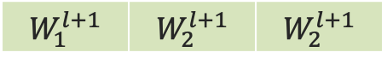
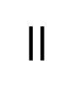

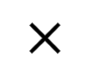
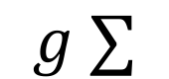


Layers Receptive Field
Let’s look at the receptive field again in 1D, no padding, stride 1 and kernel 3x1
$$a_{1}^{l+1}$$
$$a_{2}^{l+1}$$
$$a_{3}^{l+1}$$
$$=$$
$$W_{1}^{l+1}$$ | $$W_{2}^{l+1}$$ | $$W_{2}^{l+1}$$
$$g ∑$$
$$×$$
$$×$$
$$×$$
layer l

Slide 37
Layers Receptive Field
Let’s look at the receptive field again in 1D, no padding, stride 1 and kernel 3x1

Slide 38
Layers Receptive Field
Let’s look at the receptive field again in 1D, no padding, stride 1 and kernel 3x1

Slide 39
Layers Receptive Field
Let’s look at the receptive field again in 1D, no padding, stride 1 and kernel 3x1

Slide 40
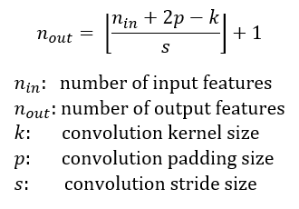
Layer’s Receptive Field
The receptive field is defined as the region in the input space that a particular CNN’s feature is looking at (i.e. be affected by).
Apply a convolution C with kernel size k = 3x3, padding size p = 1x1, stride s = 2x2 on an input map 5x5, we will get an output feature map 3x3 (green map).

Slide 41
Layer’s Receptive Field
Applying the same convolution on top of the 3x3 feature map, we will get a 2x2 feature map (orange map)

Slide 42
Layers Receptive Field
Let’s look at the receptive field again in 1D, no padding, stride 1 and kernel 3x1

Slide 43
Dilated CNNs
Let’s look at the receptive field again in 1D, no padding, stride 1 and kernel 3x1.
Skip some of the connections

Slide 44

Dilated CNNs

Slide 45
Outline
Review from last lecture
Training CNNs
BackProp of MaxPooling layer
Layers Receptive Field
Saliency maps
Transfer Learning
A bit of history

Slide 46
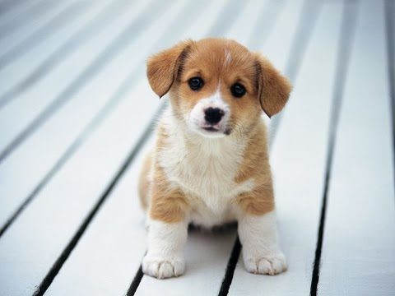
Saliency maps (cont)
If you are given an image of a dog and asked to classify it.
Most probably you will answer immediately – Dog! But your Deep Learning Network might not be as smart as you. It might classify it as a cat, a lion or Pavlos!
What are the reasons for that?
bias in training data
no regularization
or your network has seen too many celebrities

Slide 47
Saliency maps (cont)
We want to understand what made my network give a certain class as output?
Saliency Maps, they are a way to measure the spatial support of a particular class in a given image.
“Find me pixels responsible for the class C having score S(C) when the image I is passed through my network”.

Slide 48
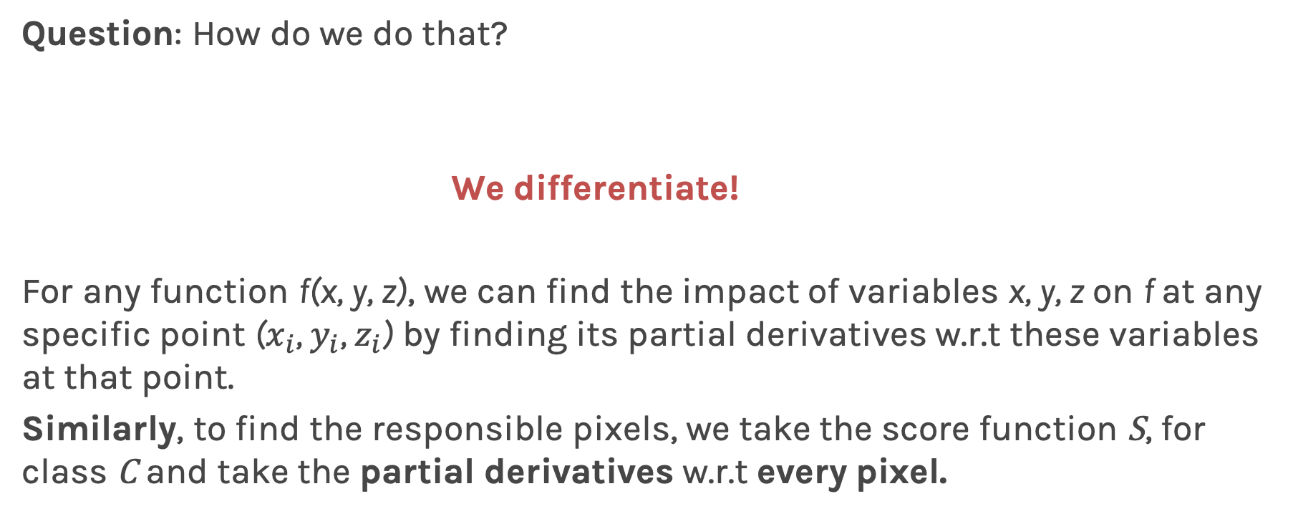
Salience maps (cont)
Question: How do we do that?
We differentiate!
For any function f(x, y, z), we can find the impact of variables x, y, z on f at any specific point ($x_{i}$, $y_{i}$, $z_{i}$) by finding its partial derivatives w.r.t these variables at that point.
Similarly, to find the responsible pixels, we take the score function S, for class C and take the partial derivatives w.r.t every pixel.

Slide 49
Salience maps (cont)
Question: Easy Peasy?
Sort of! Auto-grad can do this!
Forward pass of the image through the network.
Calculate the scores for every class.
Enforce derivative of score S at last layer for all classes except class C to be 0. For C, set it to 1
Backpropagate this derivative till the start
Render them and you have your Saliency Map!
Note: On step #2. Instead of doing softmax, we turn it to linear and use the logits.

Slide 50
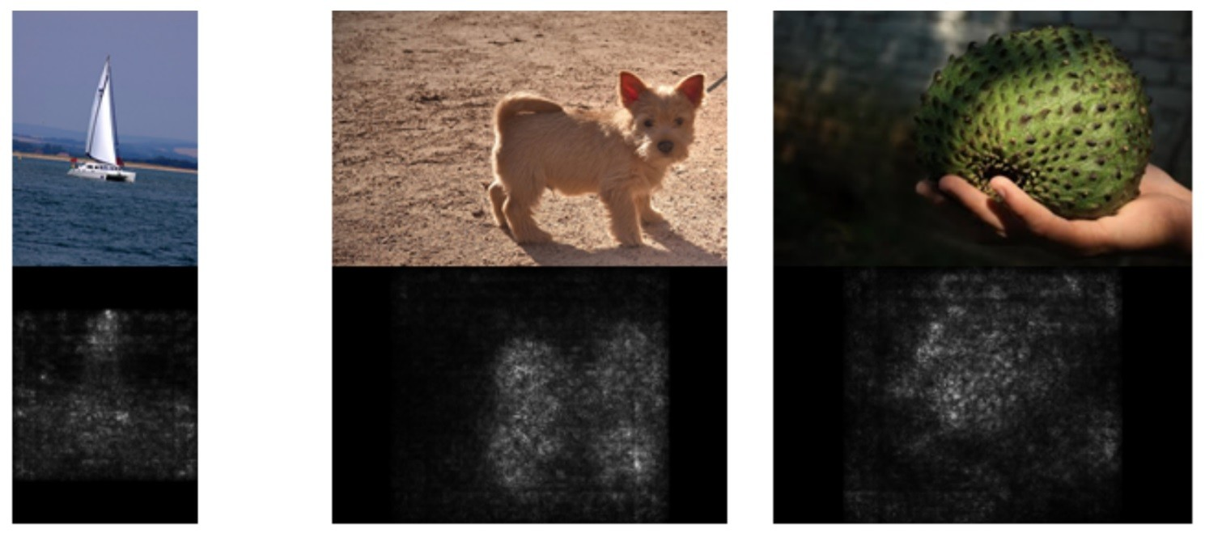
Salience maps (cont)

Slide 51
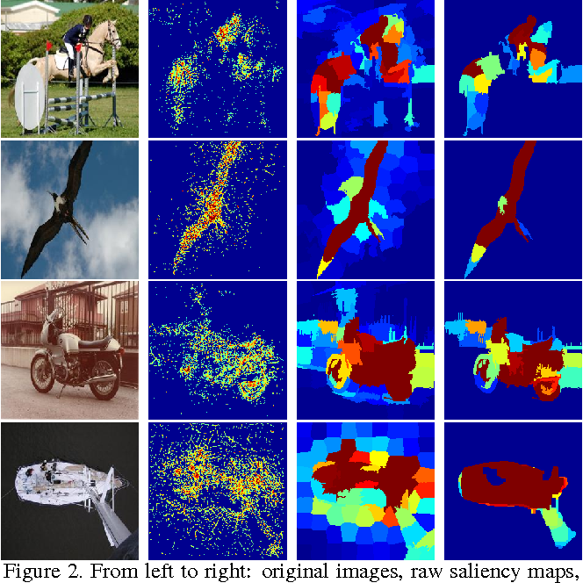
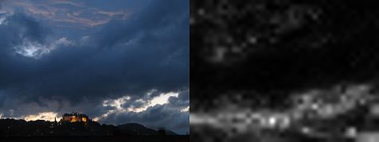
Salience maps (cont)
Question: What do we do with color images?
Take the saliency map for each channel and either take the max or average or use all 3 channels.
[1]: Deep Inside Convolutional Networks: Visualising Image Classification Models and Saliency Maps
[2]: Attention-based Extraction of Structured Information from Street View Imagery

Slide 53
Outline
Review from last lecture
Training CNNs
BackProp of MaxPooling layer
Layers Receptive Field, dilated CNNs
Saliency maps
Transfer Learning
A bit of history

Slide 54

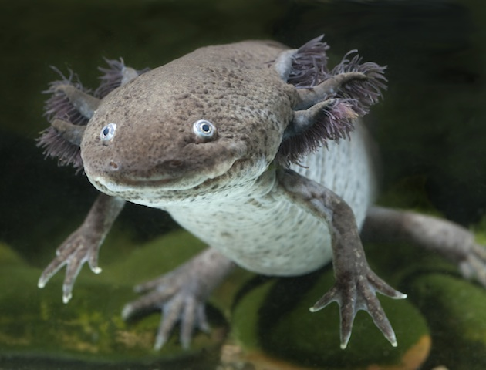
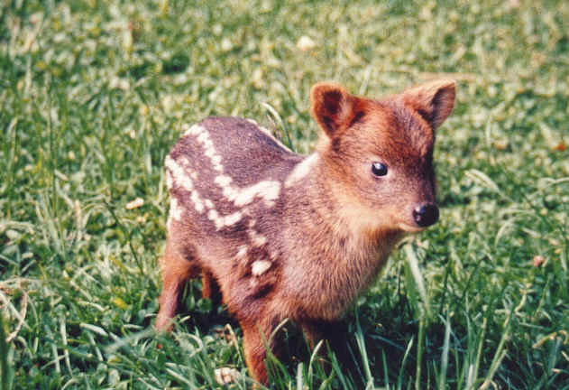
Classify Rarest Animals
VGG16
NOT ENOUGH DATA
Number of parameters: 134,268,737
Data Set: Few hundred images
Notes:
axolotl mexican, pudu

Slide 55
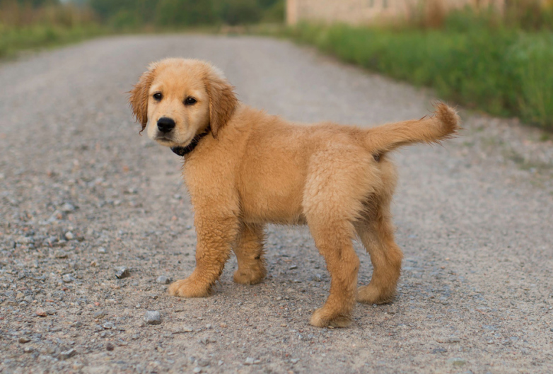
Classify Cats, Dogs, Chinchillas etc
VGG16
TAKES TOO LONG
Number of parameters: 134,268,737
Enough training data. ImageNet approximate 1.2M

Slide 56

Transfer Learning To The Rescue
How do you build an image classifier that can be trained in a few minutes on a CPU with very little data?

Slide 57
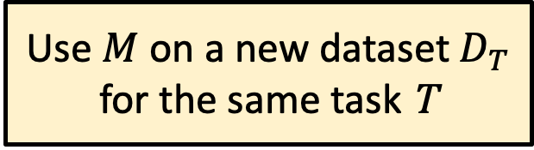
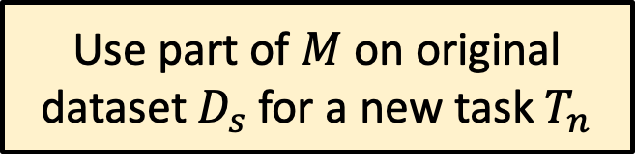
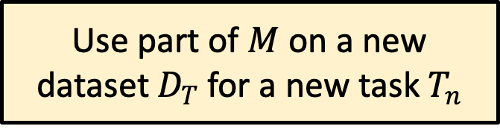
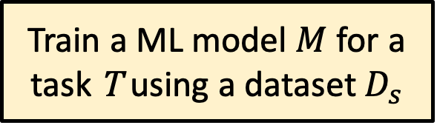
Basic idea of Transfer Learning
Train a ML model $M$ for a task T using a dataset $D_{s}$
Wikipedia:
Transfer learning (TL) is a research problem in machine learning (ML) that focuses on storing knowledge gained while solving one problem and applying it to a different but related problem.^{[1]}
Use $M$ on a new dataset $D_{T}$ for the same task T
Use part of $M$ on original dataset $D_{s}$ for a new task $T_{n}$
Use part of $M$ on a new dataset $D_{T}$ for a new task $T_{n}$

Slide 58
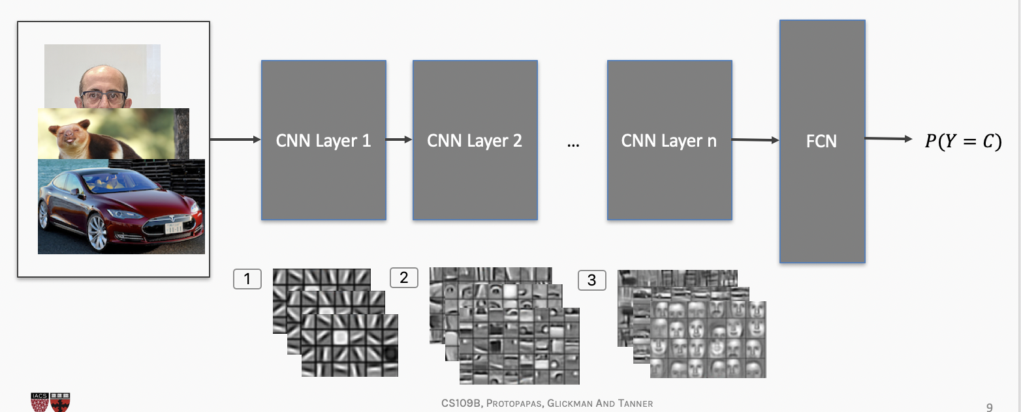
Transfer Learning To The Rescue
How do you make an image classifier that can be trained in a few minutes on a CPU with very little data?
Use pre-trained models, i.e., models with known weights.
Main Idea: earlier layers of a network learn low level features, which can be adapted to new domains by changing weights at later and fully-connected layers.
Example: use ImageNet trained with any sophisticated huge network. Then retrain it on a few images

Slide 59
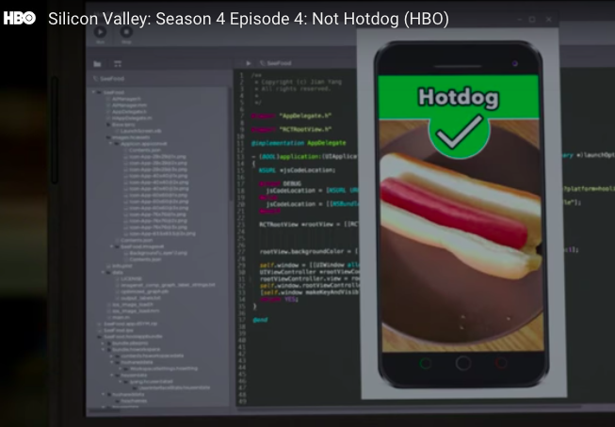
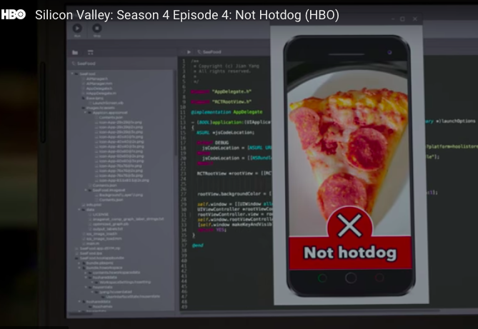
Hotdog or NotHotDog: https://youtu.be/ACmydtFDTGs (offensive language and tropes alert)

Slide 60
Transfer Learning (cont)
• train on a big "source" data set, with a big model, on one particular downstream tasks (say classification). Do it once and save the parameters. This is called a pre-trained model.
• use these parameters for other smaller "target " datasets, say, for classification on new images (possibly different domain, or training distribution), or for image segmentation on old images (new task), or new images (new task and new domain).
• less helpful if you have a large target dataset with many labels.
• will fail if source domain (where you trained big model) has nothing in common with target domain (that you want to train on smaller data set).

Slide 61
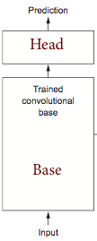
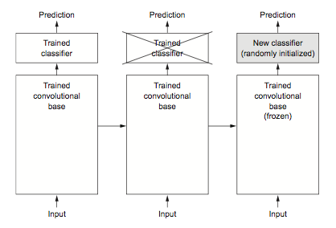
Transfer Learning (cont)

Slide 62
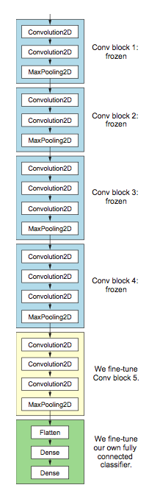
Transfer Learning: Fine-tuning
• Up to now we have frozen the entire convolutional base.
• Remember that earlier layers learn highly generic feature maps (edges, colors, textures).
• Later layers learn abstract concepts (dog’s ear).
• To particularize the model to our task, its often worth tuning the later layers as well.

Slide 63
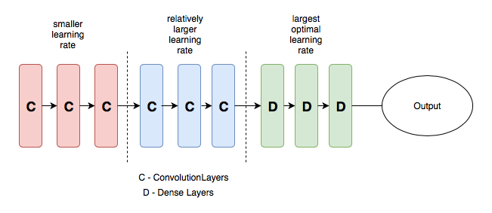
Transfer Learning: Fine-tuning
• A low learning rate can take a lot of time to train on the "later" layers. Since we trained the FC head earlier, we could probably retrain them at a higher learning rate.
• General Idea: Train different layers at different rates.
• Each "earlier" layer or layer group (the color-coded layers in the image) can be trained at 3x-10x smaller learning rate than the next "later" one.
• One could even train the entire network again this way until we overfit and then step back some epochs.

Slide 64
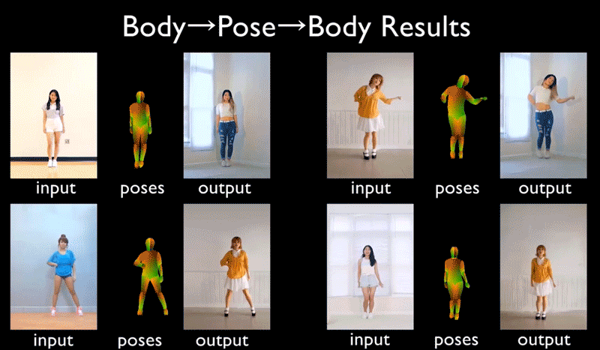
Cool Transfer learning application
NVIDIA Video to Video Synthesis - 2018

Slide 65
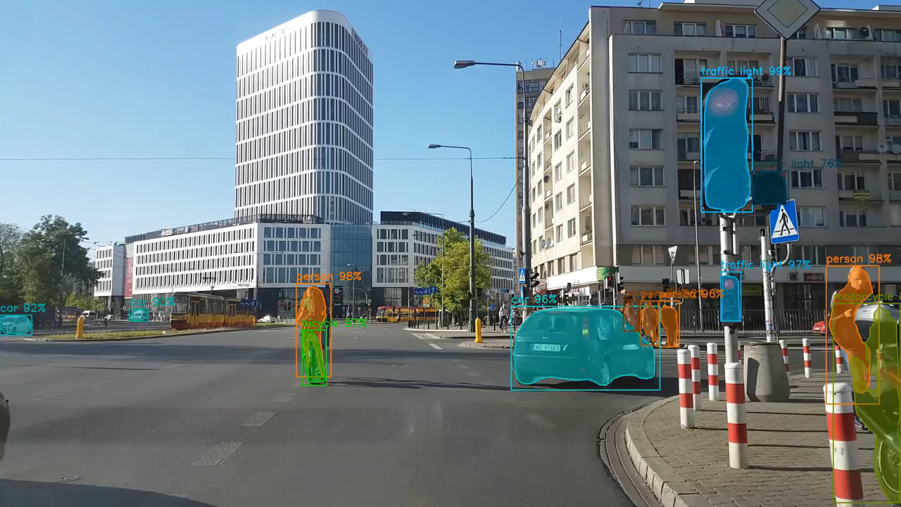
Latest events on Image Recognition
Mask- RCNN - 2017

Slide 66
Outline
Review from last lecture
Training CNNs
BackProp of MaxPooling layer
Layers Receptive Field
Saliency maps - more graphics
Transfer Learning. - AC295
Segmentation
A bit of history and SOTA

Slide 67
Initial ideas
The first piece of research proposing something similar to a Convolutional Neural Network was authored by Kunihiko Fukushima in 1980, and was called the NeoCognitron¹.
Inspired by discoveries on visual cortex of mammals.
Fukushima applied the NeoCognitron to hand-written character recognition.
End of the 80’s: several papers advanced the field
Backpropagation published in French by Yann LeCun in 1985 (independently discovered by other researchers as well)
TDNN by Waiber et al., 1989 - Convolutional-like network trained with backprop.
Backpropagation applied to handwritten zip code recognition by LeCun et al., 1989
¹ K. Fukushima. Neocognitron: A self-organizing neural network model for a mechanism of pattern recognition unaffected by shift in position. Biological Cybernetics, 36(4): 93-202, 1980.

Slide 68
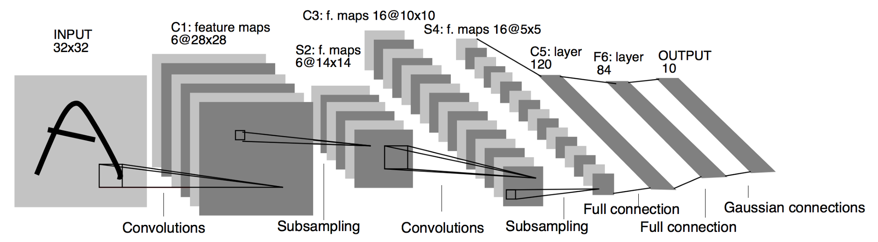
LeNet
November 1998: LeCun publishes one of his most recognized papers describing a “modern” CNN architecture for document recognition, called LeNet¹.
Not his first iteration, this was in fact LeNet-5, but this paper is the commonly cited publication when talking about LeNet.
¹ LeCun, Yann, et al. "Gradient-based learning applied to document recognition." Proceedings of the IEEE 86.11 (1998): 2278-2324.

Slide 69
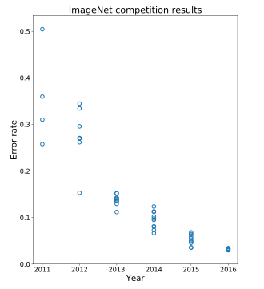

AlexNet
Developed by Alex Krizhevsky, Ilya Sutskever and Geoffrey Hinton at Utoronto in 2012. More than 25000 citations.
Destroyed the competition in the 2012 ImageNet Large Scale Visual Recognition Challenge. Showed benefits of CNNs and kickstarted AI revolution.
top-5 error of 15.3%, more than 10.8 percentage points lower than runner-up.
AlexNet
Main contributions:
Trained on ImageNet with data augmentation
Increased depth of model, GPU training (five to six days)
Smart optimizer and Dropout layers
ReLU activation!

Slide 70
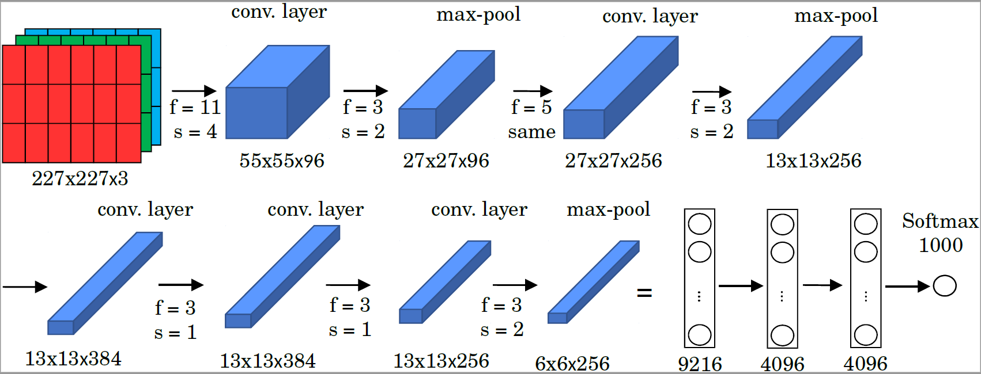
AlexNet
1.2 million high-resolution (227x227x3) images in the ImageNet 2010 contest;
1000 different classes, NN with 60 million parameters to optimize (~ 255 MB);
Uses ReLu activation functions; GPUs for training, 12 layers.

Slide 71
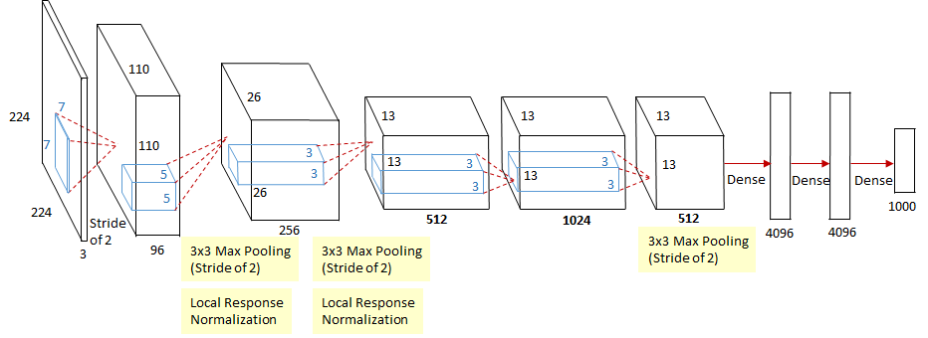
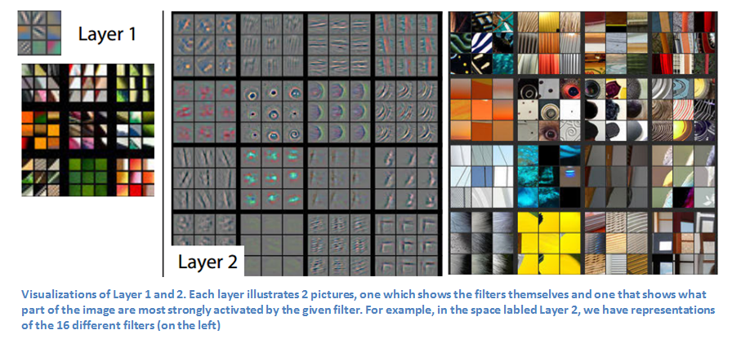
ZFNet
Introduced by Matthew Zeiler and Rob Fergus from NYU, won ILSVRC 2013 with 11.2% error rate. Decreased sizes of filters.
Trained for 12 days.
Paper presented a visualization technique named Deconvolutional Network, which helps to examine different feature activations and their relation to the input space.

Slide 72
VGG
Introduced by Simonyan and Zisserman (Oxford) in 2014
Simplicity and depth as main points. Used 3x3 filters exclusively and 2x2 MaxPool layers with stride 2.
Showed that two 3x3 filters have an effective receptive field of 5x5.
As spatial size decreases, depth increases.
Trained for two to three weeks.
Still used as of today.
VGG16

Slide 73
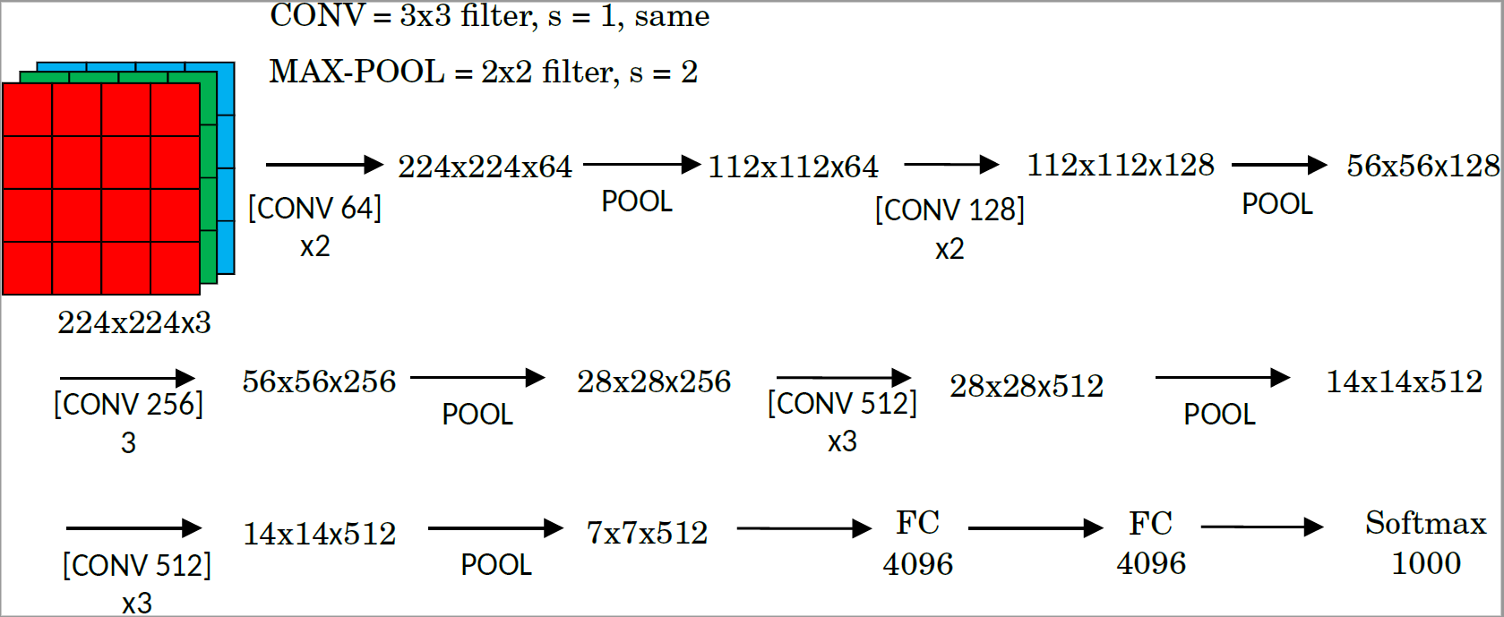
VGG
ImageNet Challenge 2014; 16 or 19 layers; 138 million parameters (~ 522 MB).
Convolutional layers use ‘same’ padding and stride s=1.
Max-pooling layers use a filter size f=2 and strie s=2.

Slide 74
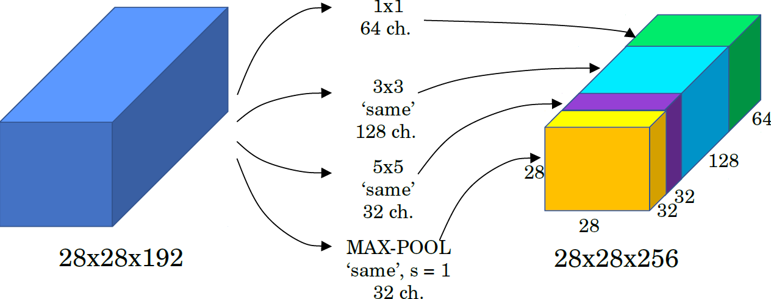
SOTA Deep Models: Inception (GoogLeNet)
The motivation behind inception networks is to use more than a singe type of convolution layer at each layer.
Use 1 x 1,3 x 3,5 x convolutional layers, and max-pooling layers in parallel.
All modules use same convolution.
Basic implementation:

Slide 75
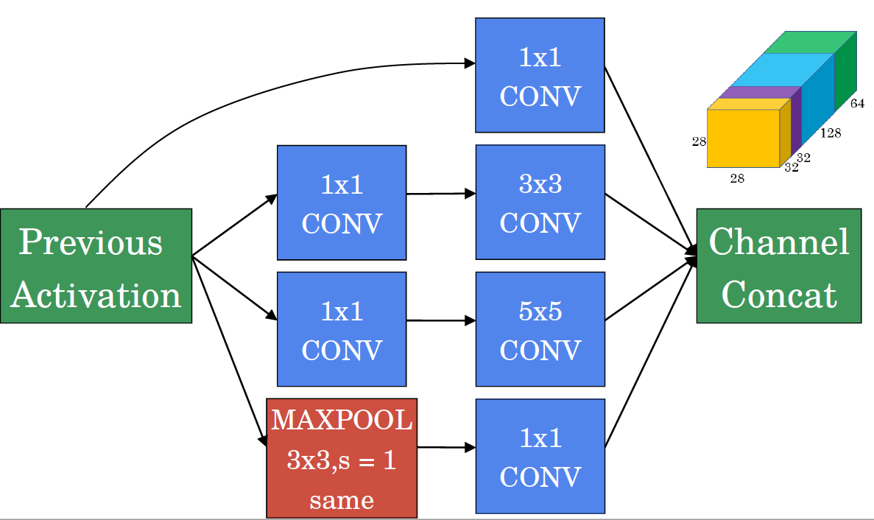
SOTA Deep Models: Inception (GoogLeNet)
Use 1 x 1 convolutions that reduce the size of the channel dimension.
The number of channels can vary from the input to the output..

Slide 76
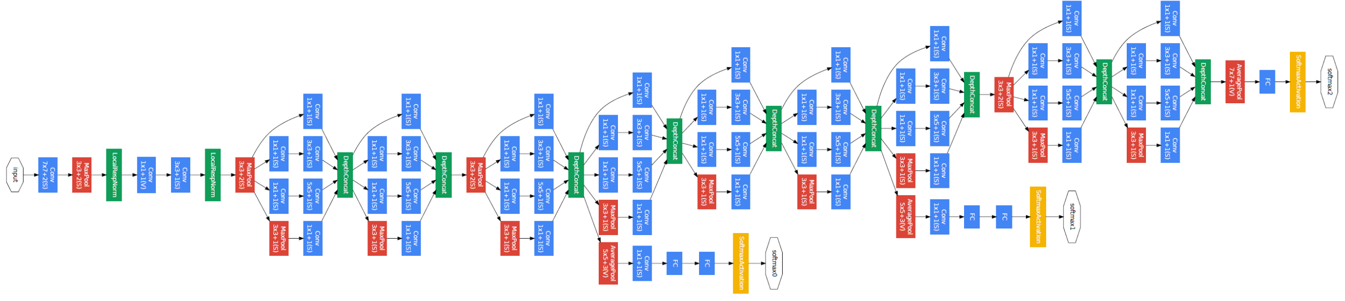
SOTA Deep Models: Inception (GoogLeNet)
The inception network is formed by concatenating other inception modules.
It includes several softmax output units to enforce regularization.

Slide 77
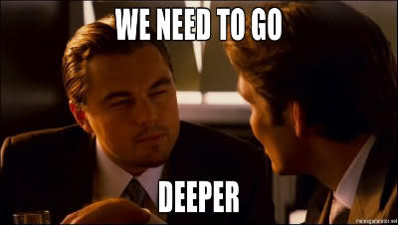

Slide 78

ResNet
Presented by He et al. (Microsoft), 2015. Won ILSVRC 2015 in multiple categories.
Main idea: Residual block. Allows for extremely deep networks.
Authors believe that it is easier to optimize the residual mapping than the original one. Furthermore, residual block can decide to “shut itself down” if needed.
Residual Block

Slide 79


ResNet
Residual nets appeared in 2016 to train very deep NN (100 or more layers).
Their architecture uses ‘residual blocks’.
Plain network structure:
Residual network block

Slide 80
ResNet
The residual network stacks blocks sequentially
The idea is to allow the network to become deeper without increasing the training time

Slide 81

ResNet
Residual networks implement blocks with convolutional layers that use ‘same’ padding option (even when max-pooling).
– This allows the block to learn the identity function.
􏰀 The designer may want to reduce the size of features and use ‘valid’ padding.
– In such case, the shortcut path can implement a new set of convolutional layers that reduces the size appropriately.

Slide 82
ResNet

Slide 83



SOTA Deep Models: MobileNet
Standard Convolution
Depth-Wise Separable Convolution (DW)
Filters and combines inputs into a new set of outputs in one step
It combines a depth wise convolution and a pointwise convolution
Input: 12x12x3
Filter: 5x5x3
Output: 8x8x3
(no padding)
Input: 12x12x3
Filter: 5x5x3x256
Output: 8x8x256
(no padding)
Input: 8x8x3
Filter: 1x1x3x256
Output: 8x8x256
(no padding)
MACs: (5x5)x3x256x(12x12) ~ 2.8M
Parameters: (5x5x3)x256 + 256 ~ 20K
MACs: (5x5)x3x(12x12) + 3x256x(8x8) ~ 60K
Parameters: (5x5x3 + 3) + (1x1x3x256+256) ~ 1K

Slide 84

SOTA Deep Models: DenseNets
Goal: allow maximum information (and gradient) flow → connect every layer directly with each other.
DenseNets exploit the potential of the network through feature reuse → no need to learn redundant feature maps.
DenseNets layers are very narrow (e.g. 12 filters), and they just add a small set of new feature-maps.

Slide 85


SOTA Deep Models: DenseNets
DenseNets do not sum the output feature maps of the layer with the incoming feature maps but concatenate them:
$$a^{\left[l\right]}=g(\left[a^{\left[0\right]}, a^{\left[1\right]}, {…, a}^{\left[l−1\right]}\right])$$
D imensions of the feature maps remains constant within a block, but the number of filters changes between them → growth rate:
$$k^{[l]}=k^{[0]}+k(l−1)$$

Slide 86
Beyond
MobileNetV2 (https://arxiv.org/abs/1801.04381)
Inception-Resnet, v1 and v2 (https://arxiv.org/abs/1602.07261)
Wide-Resnet (https://arxiv.org/abs/1605.07146)
Xception (https://arxiv.org/abs/1610.02357)
ResNeXt (https://arxiv.org/pdf/1611.05431)
ShuffleNet, v1 and v2 (https://arxiv.org/abs/1707.01083)
Squeeze and Excitation Nets (https://arxiv.org/abs/1709.01507 )

Slide 87
What’s next
Advanced topics start today on Transfer Learning :
4:30pm @ MD 115
Next Week:
Segmentation –
Autoencoders
Start of RNNs

Slide 88



Advanced Sec. 2: Object Detection and Semantic Segmentation
IMAGE CLASSIFICATION assigning 1 single label to the entire picture = Easy!
Algorithms.: VGG/Resnet/Densenet
OBJECT DETECTION detect, classify and locate every object in the picture
Algorithms: R-CNN/Fast-R-CNN/Faster-R-CNN & YOLO
SEMANTIC SEGMENTATION assigning a meaningful label to every pixel in the image
Algorithms: FCN & U-NET
DOG

Slide 89

Latest events on Image Recognition
You Only Look Once (YOLO) - 2016

